Slide 1
8
Luminescence centres
8.1 Vibronic absorption and emission
8.2 Colour centres
8.3 Paramagnetric impurities in ionic crystals
8.4 Solid state laser and optical amplifiers
8.5 Phosphors

Slide 2
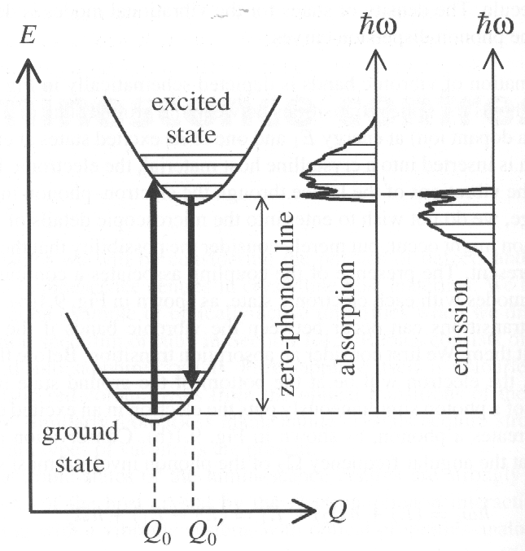
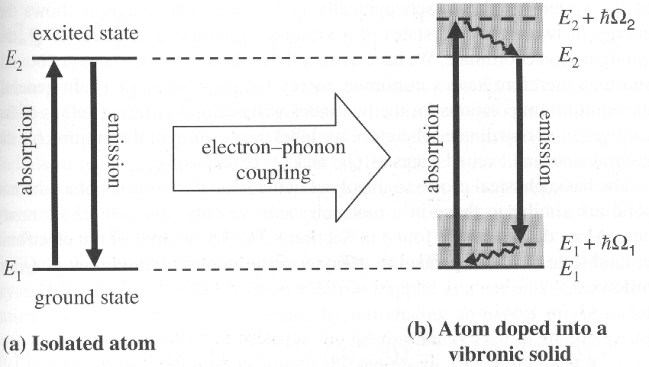
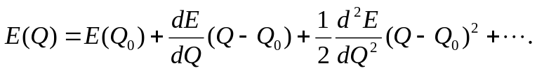
8.1 vibronic absorption and emission
Continuous vibronic bands: the electronic states are localized near specific lattice sites, and a continuous spectral bands arise by coupling the discrete electronic states to a continuous spectrum of vibrational(phonon) modes.
Emission generally occurs at lower energy than the absorption. The red shift is called the Stokes shift.
(a) Optical transition between the ground state and an excited state of an isolated atom. (b) absorption and emission transition in a vibronic solid, in which the electron-phonon interaction couples each electronic state to a continuous band of phonons.
Absorption transition:
Configuration diagram for the ground state and one of the excited electronic states of a vibronic solid. The right hand side of the figure shows the general shape of the absorption and emission spectra that would be expected. The diagram shows the energy of two electronic states of a vibronic system as a function of Q. the position of the minima for the ground state and excited states as Q₀ and Q_{o}’is labeled respectively.
The energy of the electronic ground state can be expanded as a Taylor series about the minimum at Q₀:
Absorption is possible for a band of energies from (E₂—E₁) up to the maximum energy of the phonon modes. After the photon has been absorbed, the electron relaxes non—radiatively to the bottom of the upper band, then returns to ground band by a vibronic transition of energy:

Slide 3
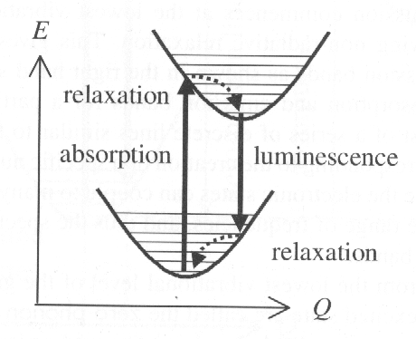
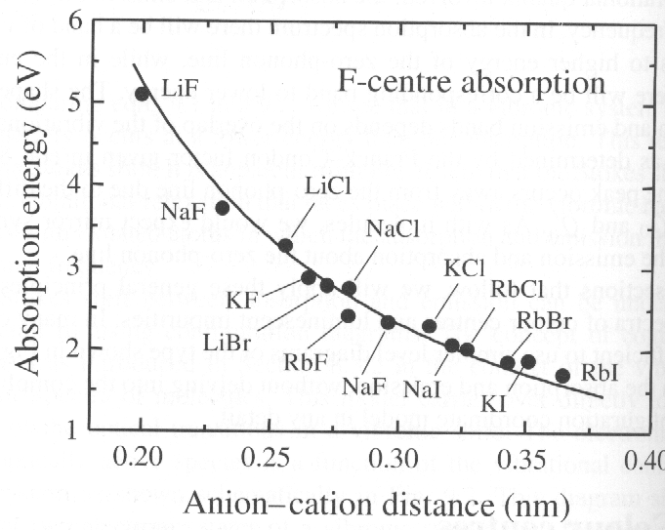
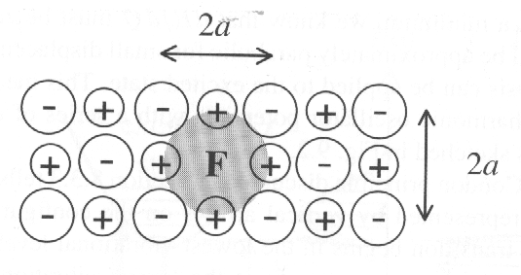
Hence the E(Q) curve will be approximately parabolic for small displacement from Q₀. In principle, the absorption and emission bands for a particular vibrational mode should consist of a series of discrete lines, each corresponding to the creation of a specific number of phonons. however, in practice the electronic states can couple to many different phonon modes with a whole range of frequencies, and thus the spectra usually fill out to form continuous bands.
8.2 Colour centres
Colour centres are optically active vacancies in ionic crystal such as the alkali halides. These defects are aptly named colour centres or F-centres
Configuration diagram corresponding to the vibronic transitions of the trapped electron in an F-centre.
An F-centre in an alkali halide crystal. The centre consists of an electron trapped at a cation vacancy. The shaded region represents the orbit of the electron.
The trapped electrons couple to the vibrations of the host crystal and this gives rise to vibronic absorption and emission. These transition are known as F-bands.
Energy (E) of the peak absorption in the F-band for several face-centre cubic alkali halide crystals. The energies are plotted against the anion-cation distance a. The solid line is a fit with E ∝1/a².

Slide 4
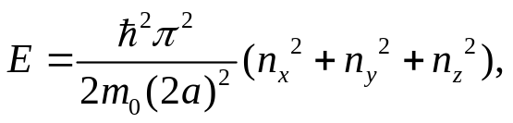
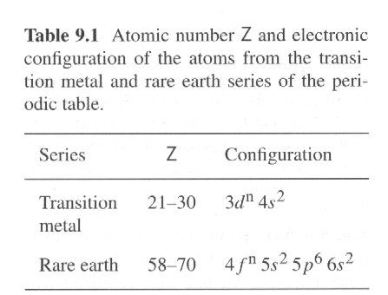
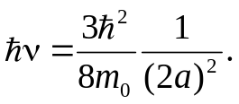
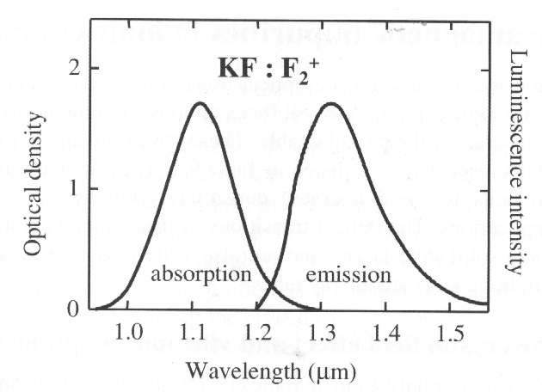
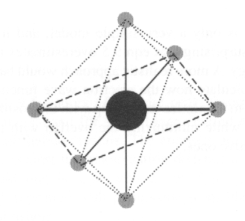
The explanation for the inverse square dependence on a. Assume the trapped electron is confined inside a rigid cubic box of dimension 2a. The energy level:
8.3 paramagnetric impurities in ionic crystals
Transition metal and rare earth series of the periodic table. They have optically active unfilled 3d or 4f shells respectively.
The lowest energy transition thus occurs at:
8.3.1 The crystal field effect and vibronic coupling
Metal ions doped as impurities in an ionic crystal substitute at the anion lattice sites. The impurities will normally be present at a low density. Main effect is the perturbation of the electronic levels of the dopant ions due to the crystalline environment in which they are placed. Generally the 4f series dopants are weakly coupled to the crystal, while the 3d series
tend to be strongly coupled.
Absorption and emission bands of the F₂⁺ centre in KF. The F₂⁺ centre consists of one electron and two holes, it has a net positive charge of one unit. The Stokes shift and the mirror symmetry between the absorption and emission is clearly evident in the data.
The octahedral crystal environ- ment. The cation dopant is surrounded by six equidistant anions which are located at the corners of an octahedron as Cr³⁺ ions in ruby are surrounded by six O²⁻ ions.

Slide 5
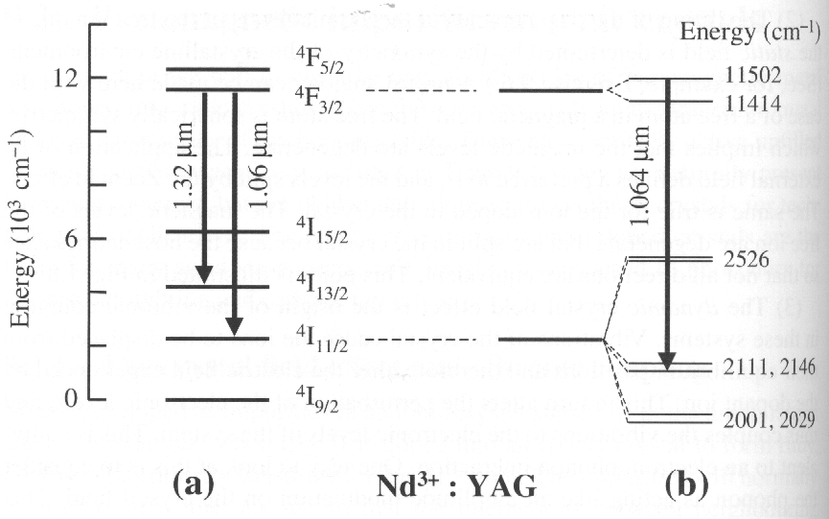
8.3.1 The crystal field effect and vibronic coupling
Structure of the free ions into fine structure terms defined by the quantum numbers L, S, J (denoted in spectroscopic notation as ^{2S+1}L_{J}). The crystal field then perturbs these states, shifting their energies slight and causing new splittings. However, the size of these shift is much smaller than the spin-orbit splittings and so the optical spectra of the dopant ions generally fairly similar to those of the free ions.
The energy levels of the dopant ion can be shifted by
the crystal field effect, and calculated by perturbation
theory. Four qualitative remarks:
There are two different crystal field contributions:
i) the static crystal field: all of the ions are at their time-averaged equilibrium positions. ii) the dynamic effect: the additional perturbation caused by displacing the neighbouring anions from their equilibrium position.
The lifting of the degeneracies of the atomic levels of the free ions due to the static field is determined by the symmetry of the crystalline environment.
The dynamic crystal field effect is the origin of the vibronic coupling.
The magnitude of the crystal field effects for the transition metal and rare earth ions are very different. When the outmost 4s electron of the transition are removed, the 3d orbitals lie on the outside of the ion and have a large radius. When the outmost 6s electrons are removed, leaving the optically active 4 f orbitals inside the filled 5 s and 5 p shells, which means they have a smaller radius and are also partly shielded from external fields. The transition metal ions are much more sensitive to the crystal field than the rare earths.
8.3.2 Rare earth ions
The spin-orbit coupling is larger than the crystal field
effect. The spin-orbit interaction splits the gross
The electronic configuration of Nd³⁺ is 4 f ³. the ground state has S=3/2, L=6 and J = 9/2, that is, a ⁴I_{9/2} term. Figure (a) shows the first five excited states without the crystal field fine structure. Two important transitions are identified, namely the ⁴F_{3/2}→ ⁴I_{13/2} line at 1.32 μm and the ⁴F_{3/2}→ ⁴I_{11/2} line at 1.06μm. (b) the octahedral symmetry of the YAG crystal field lifts the degeneracy of the m_{J} states. Thus the upper 4F_{3/2}term with m_{J} =-3/2, -1/2, 1/2 and 3/2 is split into two levels identified by |m_{J}|=3/2 and ½. Similarly, the lower ⁴I_{11/2} term splits into six sublevels. The size is approximately an order of magnitude smaller than the spin-orbit splitting.

Slide 6
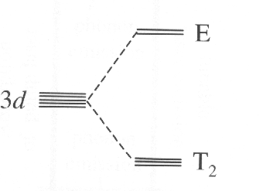
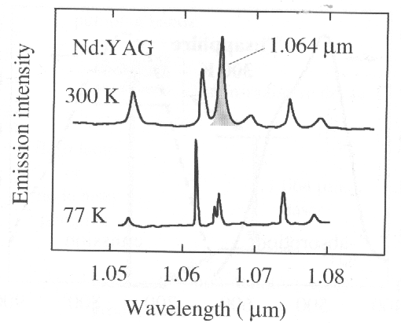
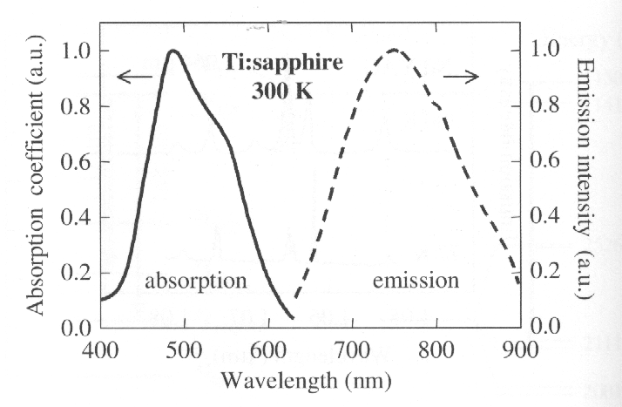
8.3.2 Rare earth ions
The metal ion Ti³⁺ has a single
3d electron with configuration
of 3d¹. It lies at the origin with
six anion nearest neighbours at
(±a,0,0), (0, ±a, 0), (0,0, ±a).
The 3d level is split into a
doublet (E) state and a triple
(T₂) state. These states can be further specified by their spin multiplicity and parity, a ²E_{g} state for the doublet and ²T_{2g} for the triplet. Superscript prefix of 2—two spin states for each electron, while subscript g refers to the parity.
Emission spectrum for the ⁴F_{3/2}→ ⁴I_{11/2} transition in a Nd:YAG crystal at 77 K and 300 K. The states involved are indicated in Fig.(b). The emission lines are broader at 300 K than at 77 K. This is a consequence of the stronger electron—phonon coupling at high temperature. The linewidth of the 1.064 μm emission line is 120 GHz at 300K, this broadening is very beneficial for making short pulse laser. And the upper state has a long lifetime of 230μs at 300K, which allows it to store energy efficiently for high pulse energies.
Absorption and emission spectra for T_{i}³⁺ ions doped into sapphire at 300 K. the spectra correspond to transitions between the T_{2g} ground state and the E_{g} excited state. The absorption and emission spectra consist of continuous bands rather than sharp lines, showing the strong vibronic broadening of the ground and the excited states. The Stokes shift and approximate mirror symmetry are also apparent in the data. The zero phonon wavelength of arround 630 nm.
8.3.3 Transition metal ions
The relatively large radius of the 3d orbitals and unshielded by outer filled shells. This makes their electronic states very sensitive to the crystalline environment, and the character of the states very different from those of the free ion.

Slide 7
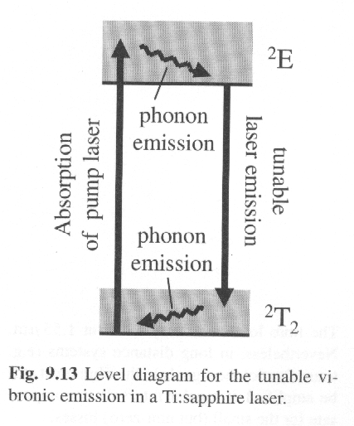
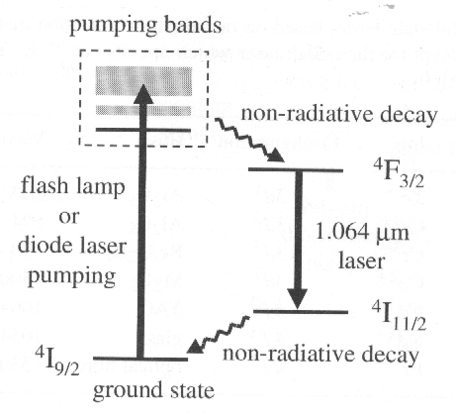
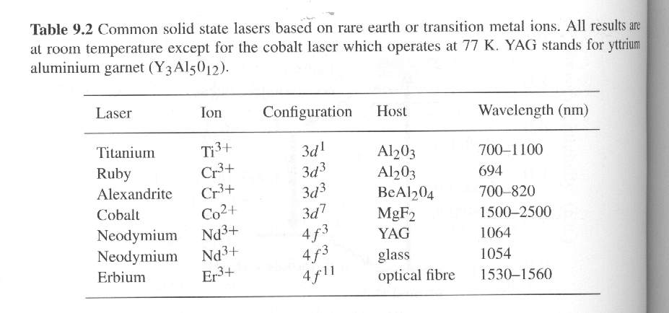
8.4 Solid state lasers and optical amplifiers
Electrons are pumped from the ground state of the ²T₂ band to an excited level within the ²E band, then relax to the bottom of the ²E band by phonon emission, and this creates population inversion with respect to the vibronic level of the ²T₂ band.
The lasers are generally classified as having either a fixed or tunable wavelength. The rare earth ions for the first category, while transition metal ions for the second.
Population inversion scheme for the 1.064 transition in a Nd:YAG laser. The upper level is the ⁴F_{3/2} state. This level is populated by first pumping electrons from the ground to excited states. Some of these are broadened into bands by vibronic coupling, can absorb a wide range of frequencies. The electrons in the higher excited states then relax to the upper level by rapid non-radiative decay. This give rise to population inversion with respect to the ⁴I_{11/2} state. Rapid non-radiative decay to ⁴I_{9/2} state ensures that the electrons do not accumulate in the lower level.

Slide 8
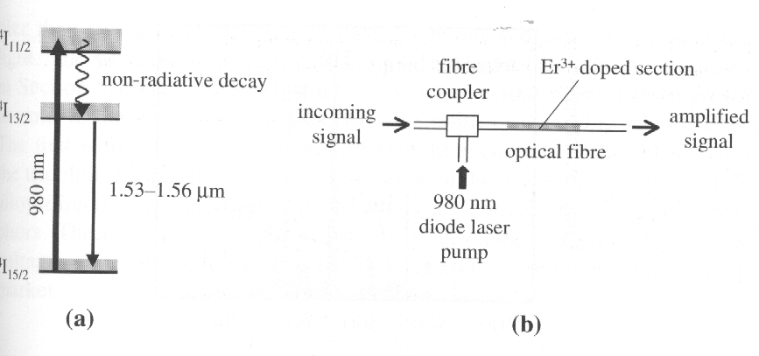
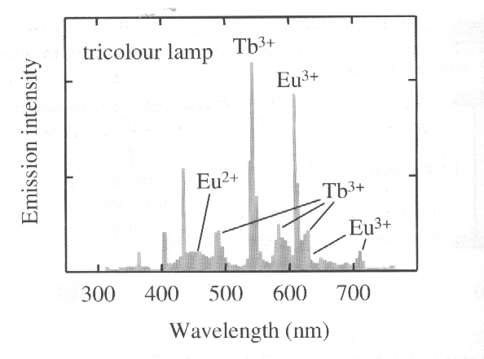


8.4 Solid state lasers and optical amplifiers
8.5 Phosphors
Phosphors find widespread application in cathode ray tubes and in fluorescent lighting. The former is excited by electron beam, while the latter excited by UV photons at 254 nm and 185 nm from a mercury discharge and re-emit in the visible.
The E_{r}—doped fibre amplifier. (a) level scheme. The ⁴I_{11/2} band is 1.27 eV above the ground state, and is suitable for pumping with 980 nm diode lasers. Rapid non-radiative relaxation occurs to the bottom of the ⁴I_{13/2} band, where the electrons accumulate due to the long lifetime of the state(11 ms). This creates population inversion for the ⁴I_{13/2}→⁴I_{15/2} vibronic transition, and hence gain between 1.53 μm and 1.56μm. (b) Schematic diagram of the fibre amplifier. 980 nm pump laser is coupled into the erbium-doped section by mean of a fibre coupler.
The colour centres can also be used as laser crystal.
Very short pulse generation:
Emission spectrum of a tricolour fluorescent lamp with a colour balance equivalent to a black body source at 4000 K. the main emission lines from the blend of Eu²⁺, Eu³⁺, and Tb³⁺ phosphors in the lamp are identified. The sharp line at 405 nm and 436 nm originate from the mercury discharge. There is also a mercury line at 545 nm which is very close to the main Tb³⁺ emission line.
White light semiconductor light emitting diodes
(white light LED’s)
The time—bandwidth product is a type of uncertainty principle. Laser crystals with broad emission lines are good candidates for generating very short pulses. The precise value depends on the shape of the pulses. If the pulses are Gaussian, for example, the linewidth of the 1064 nm in Nd:YAG is about 120 GHz at 300 K, the possible duration of pulse is as short as a few picoseconds.

